Slide 1
District Grant Applications

Slide 2
https://www.wmmethodists.org.uk
Select “Grants” on the far right as one looks at the page

Slide 3
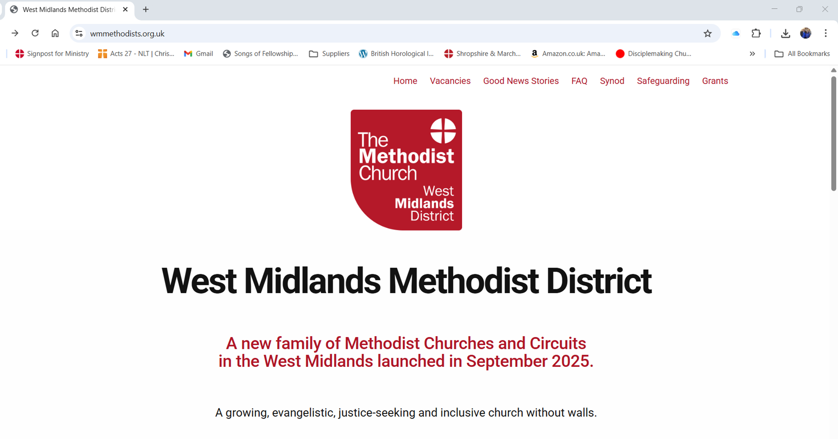

Slide 4
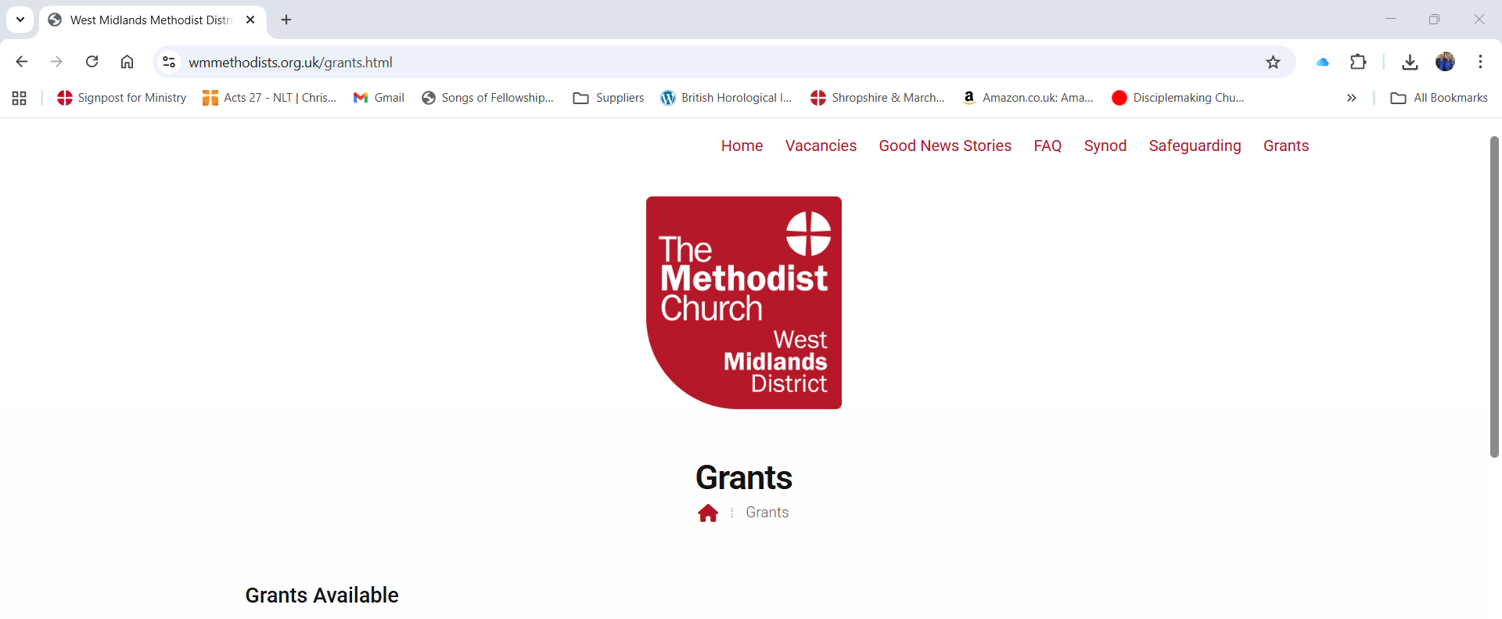

Slide 5
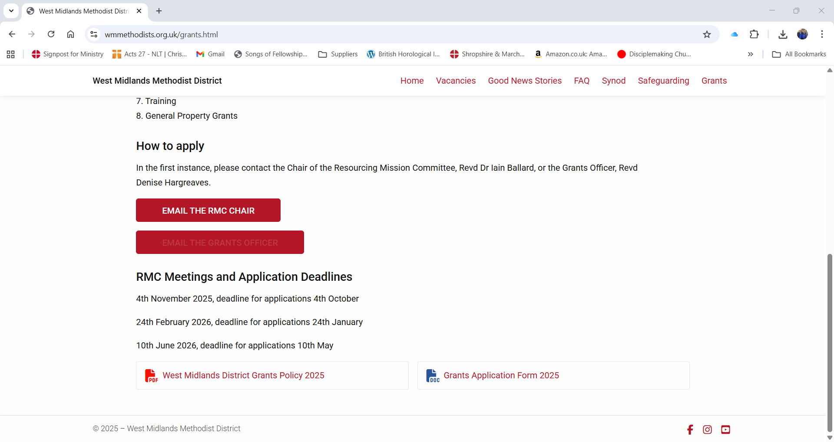

Slide 6
Grants Policy
See the Grants Policy for what you can apply for and the criteria required. This can be found at the bottom of the page on the left-hand side and is a click button.
The policy outlines:
1. General Comments
2. Grant Streams
3. Application Process
4. Appendix: Other Sources of Funding
It is essential that one reads the Grants Policy BEFORE putting in an application.

Slide 7
Grants Available for…(subject to meeting the Grants Policy criteria)
1. New Places for New People
2. Net Zero 2030 Improvements
3. Church Growth Support, including the employment of lay staff
4. Children and Young People
5. Justice Seeking Church
6. Small Grants
7. Training
8. General Property Grants

Slide 8
The Grants Application Form
Is available to download and is in Word Format
– please do not send it to me as a PDF. If I need to alter it on your behalf after speaking to you, I cannot do so if it is in PDF format.
The form is available at the bottom of the page on the right-hand side.
Do not be put off, the questions are there to help you!

Slide 9


Slide 10
At the moment the ‘email the Grants Officer’ button is not working. Therefore, use the following email…
dkah26@gmail.com
If you have any queries or questions please ASK.
I and the RMC are here to help you.

Slide 11



